Slide 1
McCormick Foundation Civics Program Teaching with Controversy
Primary Sources

Slide 2
Danielle Estler Professional Development Manager
McCormick Foundation Civics Program Primary Sources Readings

Slide 3
Improving Classroom Instruction: Understanding the Developmental Nature of Analyzing Primary Sources
Why did the authors study middle school students?
What components of analyzing primary sources were studied?
What are some of the “practical suggestions” made by the authors of this study?

Slide 4
Primary Sources in History: Breaking Through the Myths
What is your reaction to the seven myths? Have you encountered any of these?
Why does Barton recommend the term “original historical sources” and what does that encompass?
What does Barton put forward as the best arguments for using original historical sources as an instructional approach?

Slide 5
Fostering Historical Thinking With Digitized Primary Sources
What are the implications of the growth of digital image archives online for teachers and students?
What are the historical thinking behaviors that the authors refer to as expert “habits of the mind?”
What did the students identify as “different” in classes where online primary sources were use?

Slide 6
Primary Sources Readings
What are the benefits of using primary sources?
What are the challenges of using primary sources?
Why use primary sources in teaching with controversy?

Slide 7
Mary Ellen Daneels Social Studies Teacher, West Chicago Community High School
McCormick Foundation Civics Program Primary Sources in Practice

Slide 8
F-I-G
Fact, Inference and Generalization

Slide 9
Facts
Fact: Something that can be proven true
John has missed a lot of history classes.
Mary has missed a lot of history classes.
John failed the history test.
Mary missed the history test.
You could look at the teachers attendance book and ask students to prove their attendance.
You can look at the test scores to see how they performed on the test.

Slide 10
Inference
Inference: A conclusion based on evidence.
John and Mary failed the test because they have poor attendance
It is logical to assume that John and Mary failed because they have not been in class, but there could be another reason. Maybe they both were sick, and if they had been 100% well, they would have passed. Maybe they both skipped a bubble on their scantron answer sheet and that made them fail. There could be other explanations.

Slide 11
Generalization
Generalization: an overall, global statement that is not time, person or place specific.
People who do not come to class will likely fail the test.
This statement is broad and could apply to anyone, at anytime and any place.

Slide 12
F-I-G Practice
In your groups, list as many FACTS as you can from the following cartoon. One person will have to stand and share the group’s responses with the class.

Slide 13
Election Day by E.W. Gustin

Slide 14
F-I-G Practice
What inferences can you make about this cartoon? What was the message? Who was the audience it was drawn for? When was it drawn? Why was this cartoon drawn? Where was this drawn (country)?

Slide 15
Election Day by E.W. Gustin

Slide 16
Opportunity Cost
An opportunity cost is the alternative someone gives up when they make a decision.
The opportunity cost of eating a fast food hamburger for dinner is the opportunity to eat a taco or hot dog.
The opportunity cost of watching a DVD on Saturday night is the opportunity to go out to a movie, go to a concert, or to go bowling.

Slide 17
Opportunity Cost
Women who chose to participate in the suffrage movement paid a “cost”.
This cartoon makes some generalizations about the women involved in the suffrage movement.

Slide 18
F-I-G Practice
What generalizations can you make about the “cost” paid by suffragettes?

Slide 19
Election Day by E.W. Gustin

Slide 20
www.loc.gov/teachers

Slide 21
Kristina Maldre, Education Specialist
McCormick Foundation Civics Program The National Archives at Chicago

Slide 22
Introduction to Resources of the National Archives & Records Administration
National Archives at Chicago – http://www.archives.gov/great-lakes/

Slide 23
National Archives at Chicago AGENDA
Agenda for our time together:
Introduction to the National Archives & Records Administration and the Chicago branch
Introduction to Docsteach.org
World War I: Case Files on Detained Enemy Aliens
World War II: Japanese Internment through Records of the War Relocation Authority
National Archives at Chicago – http://www.archives.gov/great-lakes/

Slide 24
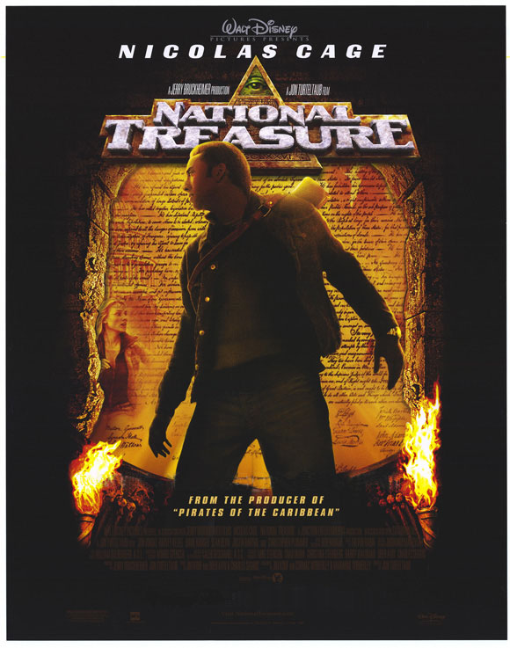
What is the National Archives & Records Administration?
National Archives at Chicago – http://www.archives.gov/great-lakes/

Slide 25
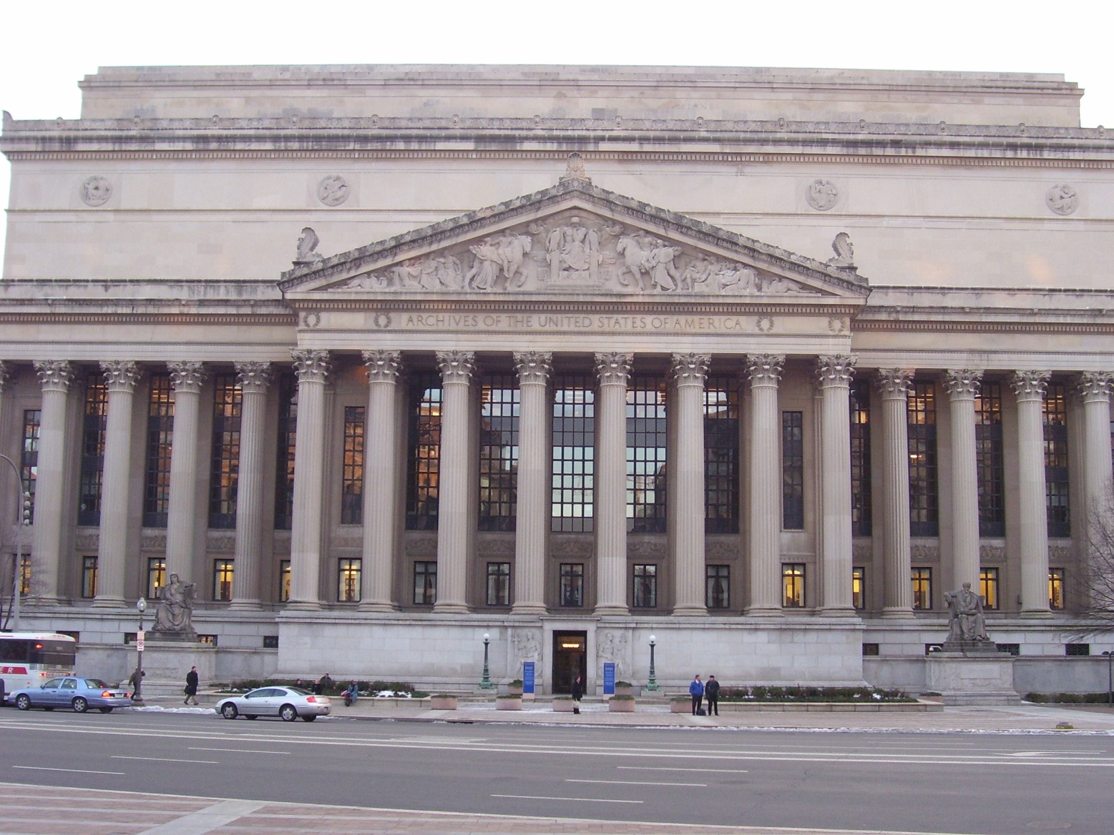
What is the National Archives & Records Administration?
National Archives at Chicago – http://www.archives.gov/great-lakes/

Slide 26
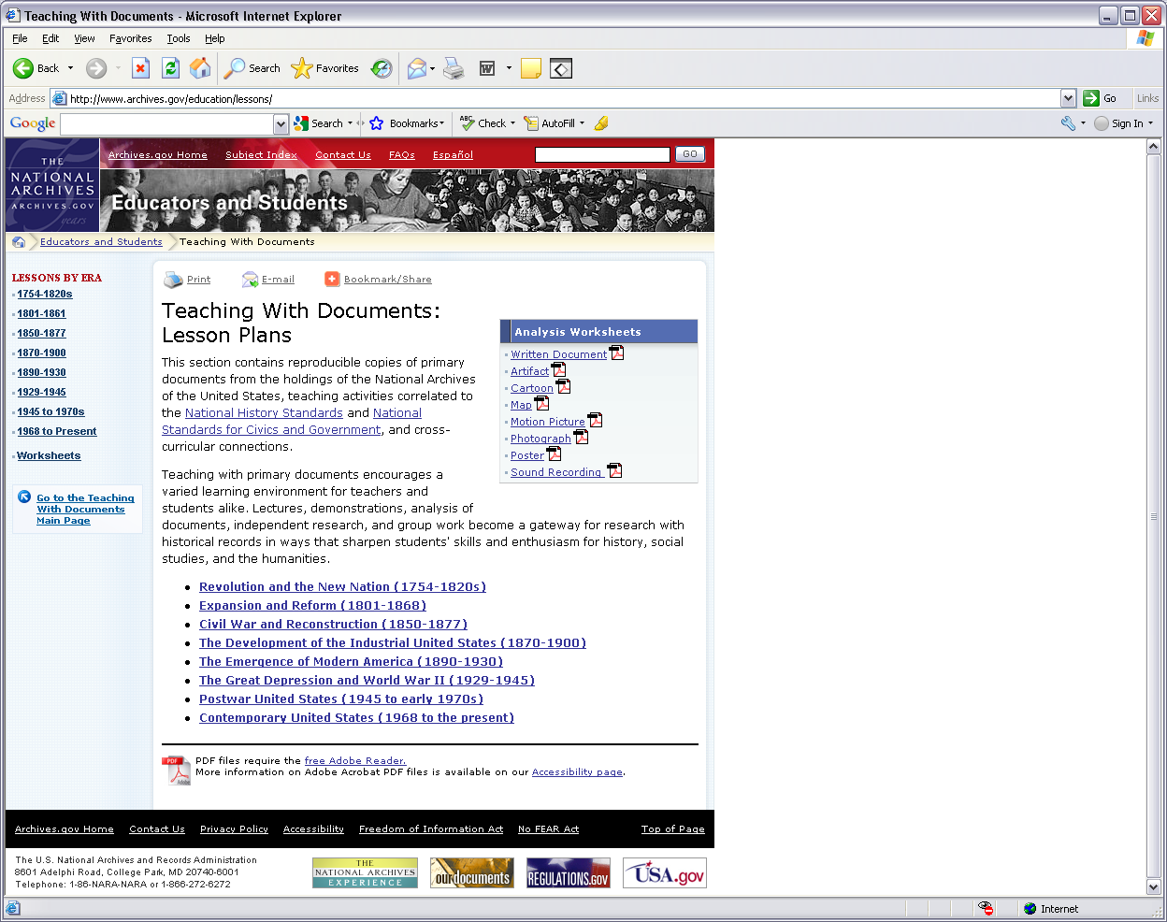
What is the National Archives & Records Administration?
National Archives at Chicago – http://www.archives.gov/great-lakes/

Slide 27
What is the National Archives & Records Administration?
As the nation's record keeper, NARA collects, protects and makes available records created by the Federal government.
Actually, only 1-3% of the documents created by the Federal government in the course of business are deemed valuable enough to be saved in perpetuity.
NARA is truly a national organization with facilities across the country, including presidential libraries.
National Public Radio (NPR) host Liane Hansen visits the National Archives in Washington, D.C., and talks with David Ferriero, the new Archivist of the United States.
Story aired on January 10, 2010. Complete version available at http://www.npr.org/templates/story/story.php?storyId=122416367
“Some 10 billion things are housed in the National Archives, from the monumental to the miniscule. And David Ferriero is in charge of them all.”
National Archives at Chicago – http://www.archives.gov/great-lakes/

Slide 28
How does the National Archives at Chicago fit into this?
National Archives at Chicago – http://www.archives.gov/great-lakes/

Slide 29
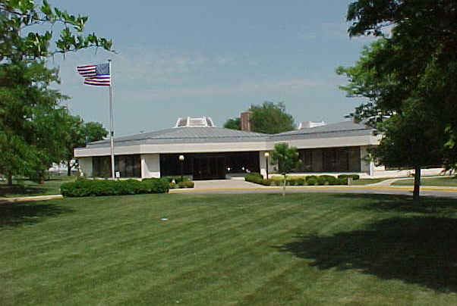
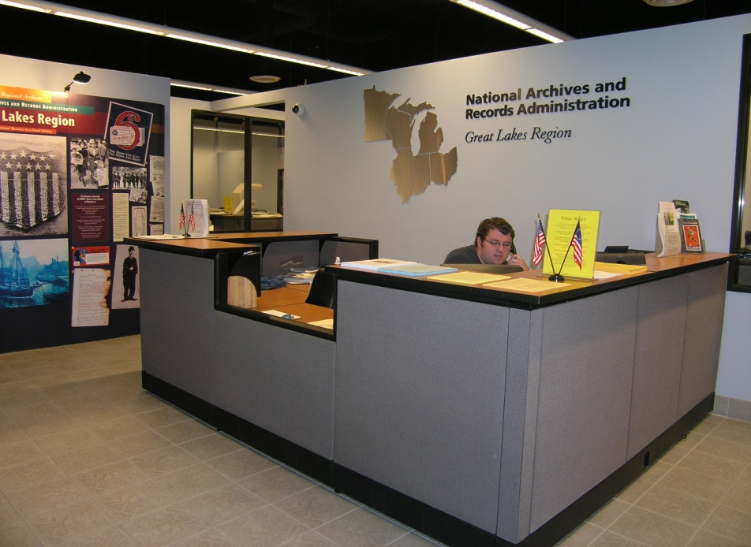
How does the National Archives at Chicago fit into this?
As a regional archives branch, The National Archives at Chicago
collects, protects, and makes available permanently valuable federal records created in the six Great Lakes states of Illinois, Indiana, Michigan, Minnesota, Ohio, and Wisconsin.
National Archives at Chicago – http://www.archives.gov/great-lakes/
Notes:
Preserves and provides access to permanently valuable federal records
CREATED
In Illinois, Indiana, Michigan, Minnesota, Ohio and Wisconsin
Exactly what type of records?

Slide 30
The National Archives at Chicago
What do these federal records from the Great Lakes look like?
National Archives at Chicago – http://www.archives.gov/great-lakes/
Notes:
Exactly what type of records

Slide 31
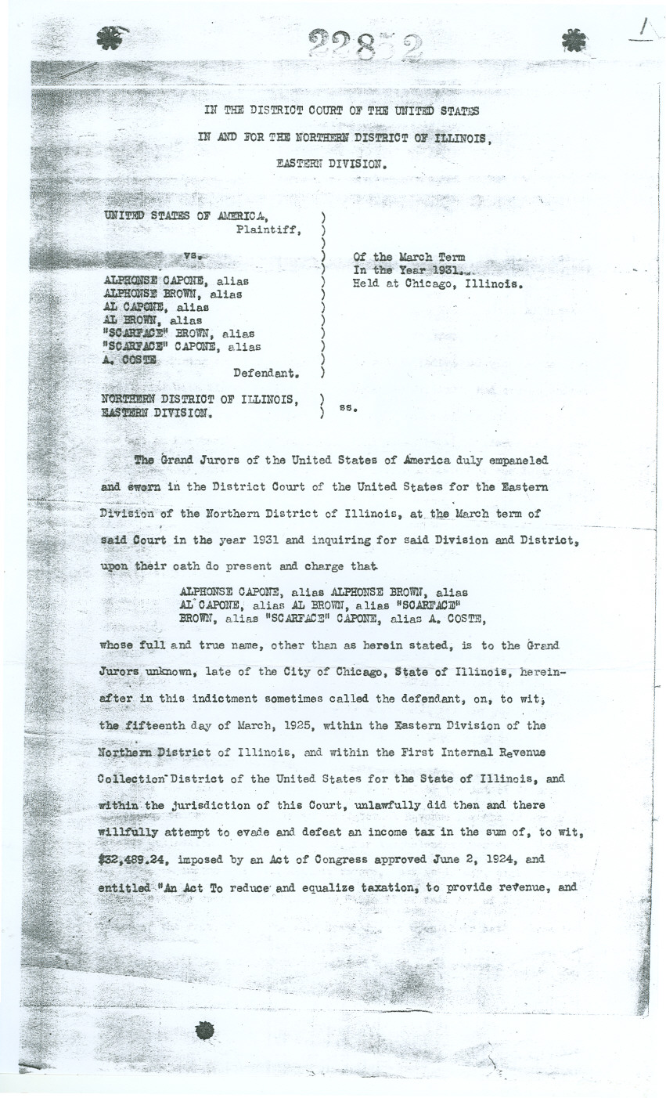
The National Archives at Chicago
National Archives at Chicago – http://www.archives.gov/great-lakes/

Slide 32
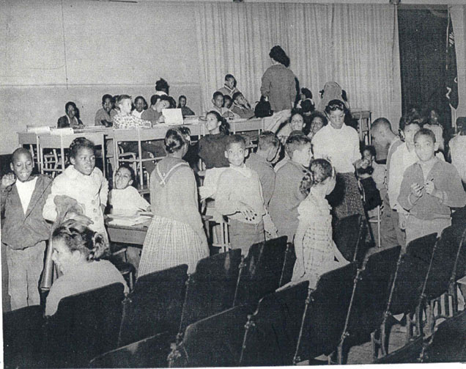
The National Archives at Chicago
National Archives at Chicago – http://www.archives.gov/great-lakes/
Notes:
Record Group 21: US District Court, Northern Illinois, Eastern Division, Case 63C1895 “James Webb vs. The Board of Education, City of Chicago and Benjamin Willis, as general superintendent of CPS.”

Slide 33
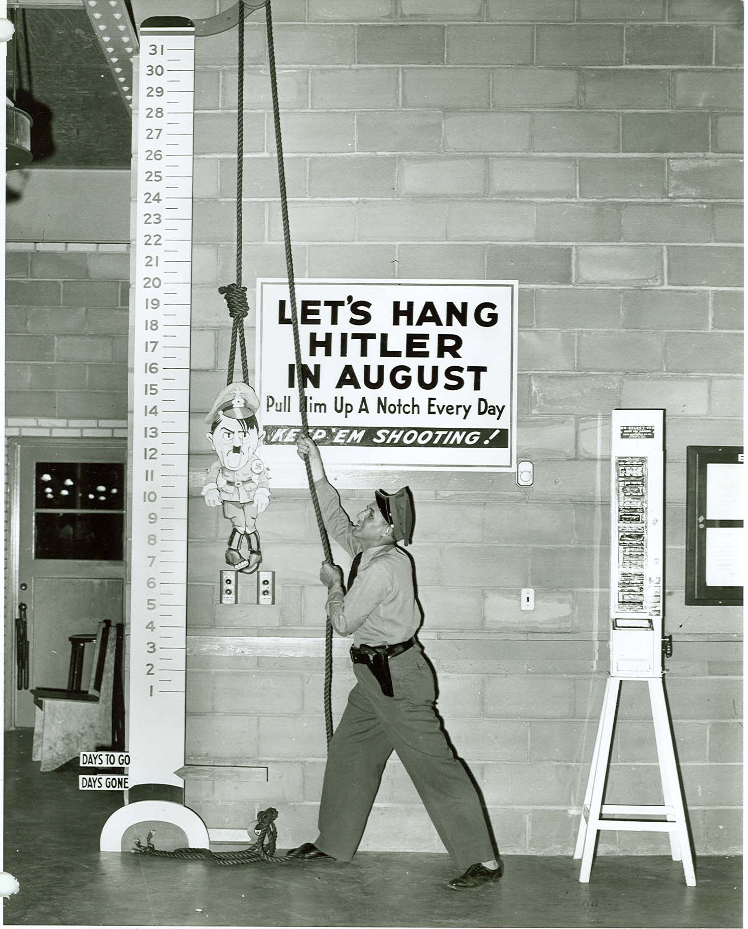
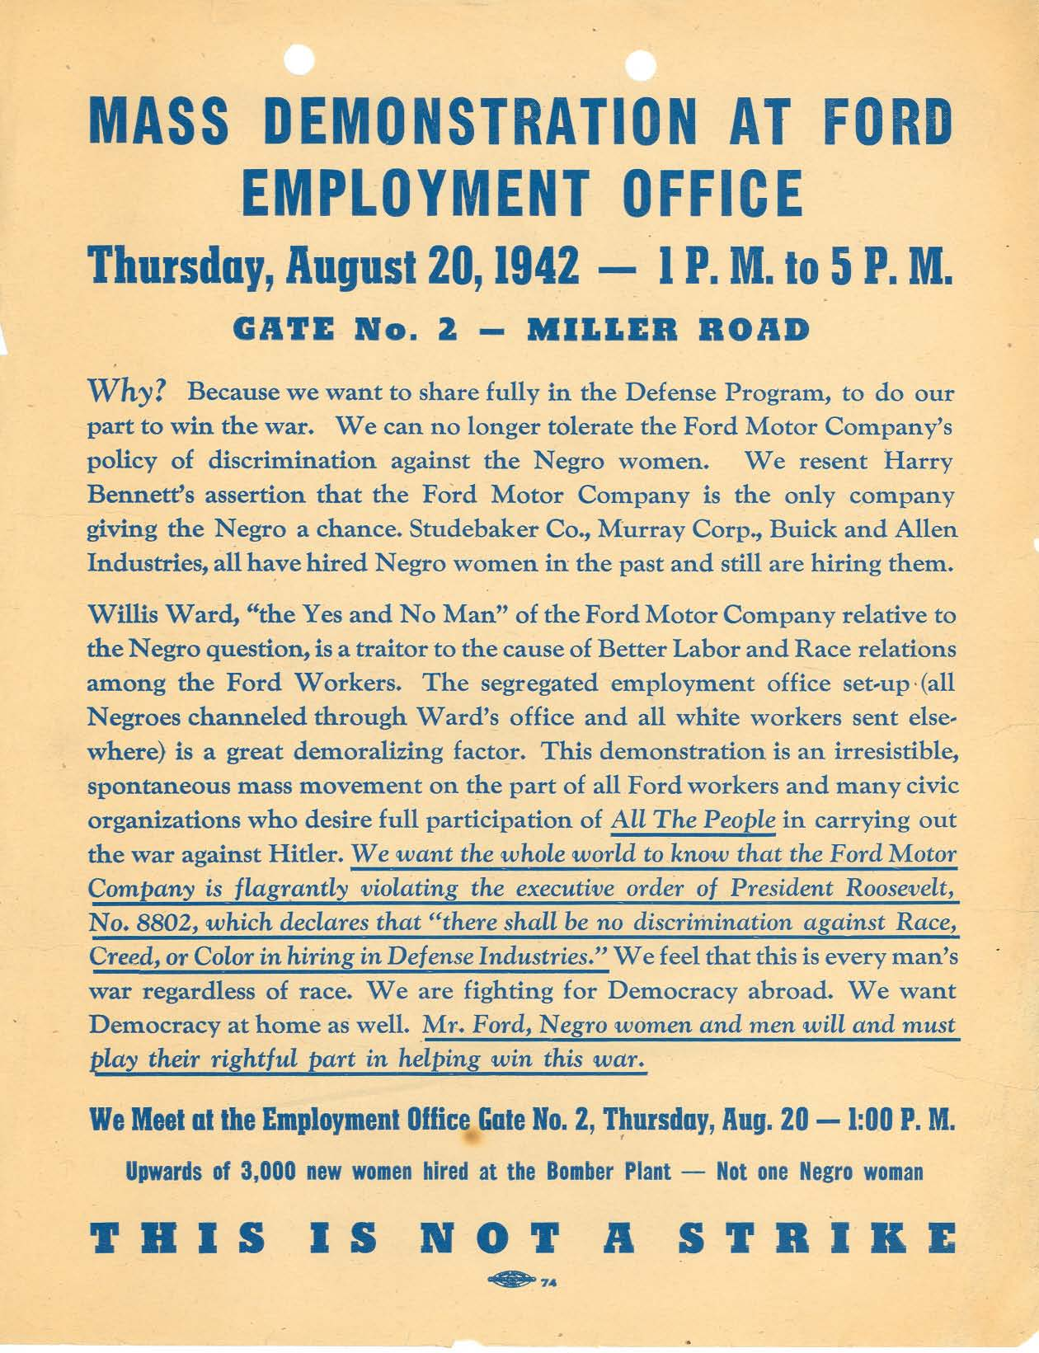
The National Archives at Chicago
National Archives at Chicago – http://www.archives.gov/great-lakes/
Notes:
RG 228: Records of the Committee on Fair Employment Practice
RG 156:
Records from the Twin Cities Ordnance Plant

Slide 34
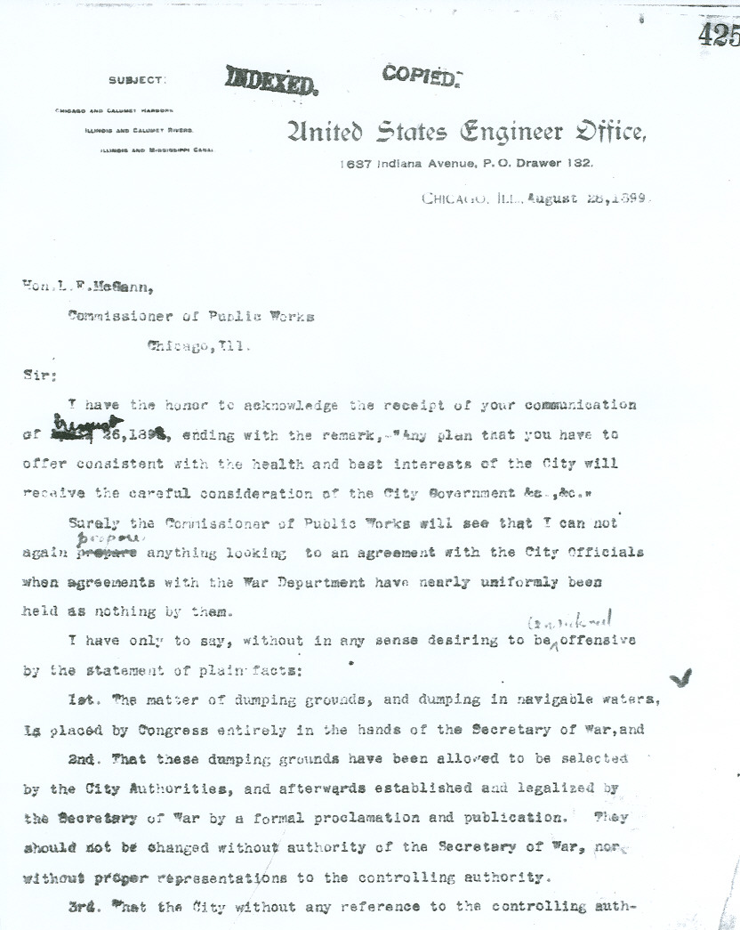
The National Archives at Chicago
National Archives at Chicago – http://www.archives.gov/great-lakes/

Slide 35
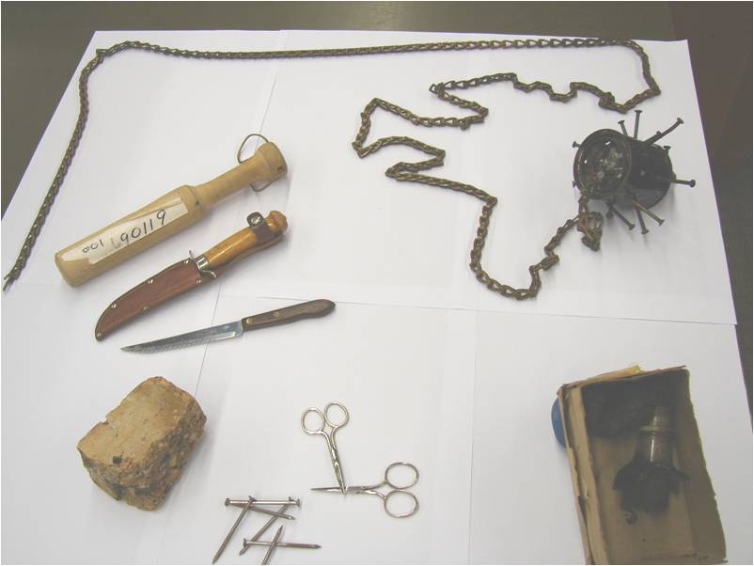
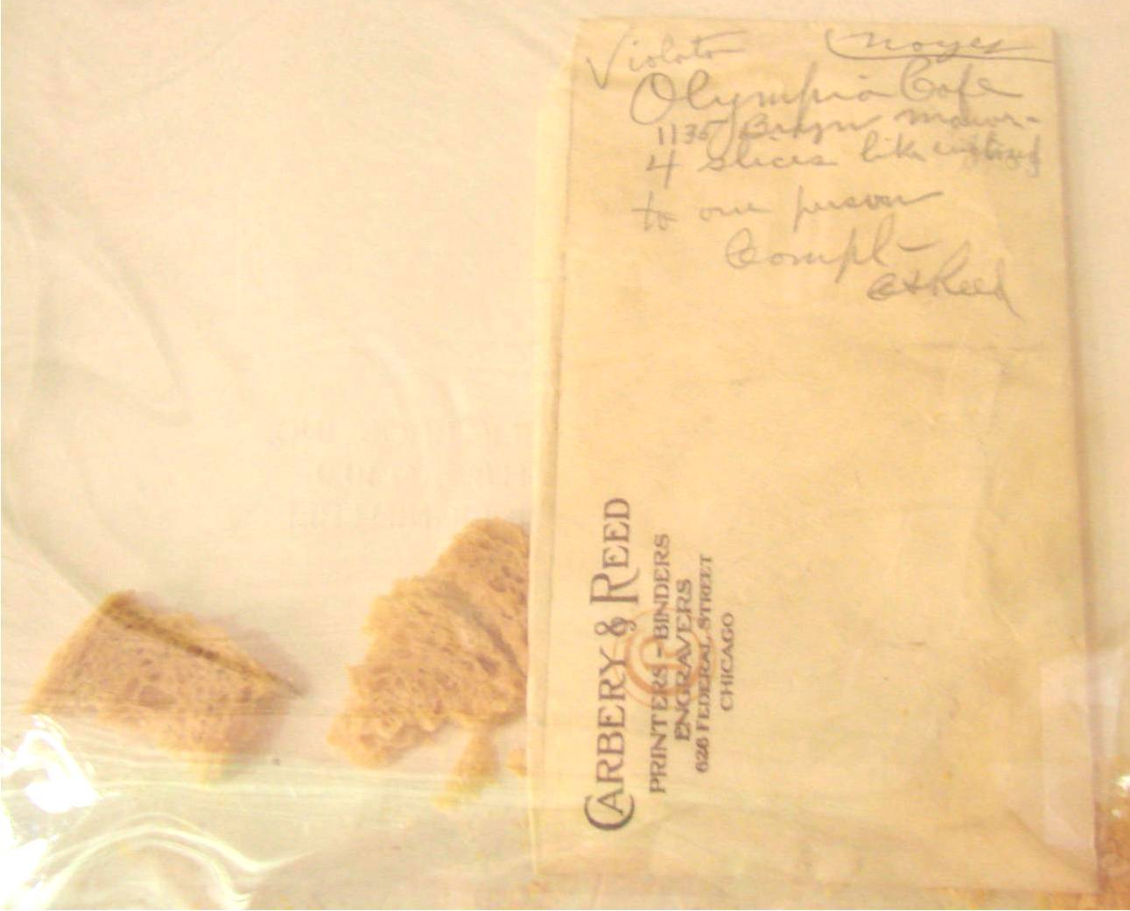
The National Archives at Chicago
National Archives at Chicago – http://www.archives.gov/great-lakes/
Notes:
Exhibits from the chicago 7 trial – 1968 chicago democratic convention
RG 4: records of the food administration
Bureau of investigation – complaint against restaurant serving too much bread. Enclosed slices.
90+ year old bread

Slide 36
The National Archives at Chicago
Where do you start?
Scenario 1: Time is on your side, eager to visit the archives and work with original documents.
Holdings Guide available at http://www.archives.gov/great-lakes/holdings/
Subject Index
ASK our terrific archivists = e-mail: chicago.archives@nara.gov
Scenario 2: I’ll wait until the summer to visit. Right now on-line and accessible is preferred.
National Archives at Chicago – http://www.archives.gov/great-lakes/

Slide 37
Research at the National Archives at Chicago
Where do you start?
Scenario 2: On-line & Accessible
□ Docs Teach web site at http://docsteach.org/
Latest web site from the National Archives
National Archives’ primary sources from across the country
Online tool to access primary sources and create online learning activities for your students.
National Archives at Chicago – http://www.archives.gov/great-lakes/
Notes:
.
. .

Slide 38
National Archives - DocsTeach – http://docsteach.org
National Archives’ Docs Teach– http://docsteach.org

Slide 39
National Archives - DocsTeach – http://docsteach.org
“Ready-to-roll” Activities:
Example:
Focusing on the Details: Black out/White Out
http://docsteach.org/activities/63

Slide 40
National Archives - DocsTeach – http://docsteach.org
“Ready-to-roll” Activities:
Example:
Weighing the Evidence
How Effective Were the Efforts of the Freedom’s Bureau?
http://docsteach.org/activities/28
National Archives’ Docs Teach– http://docsteach.org

Slide 41
National Archives - DocsTeach – http://docsteach.org
National Archives’ Docs Teach– http://docsteach.org

Slide 42
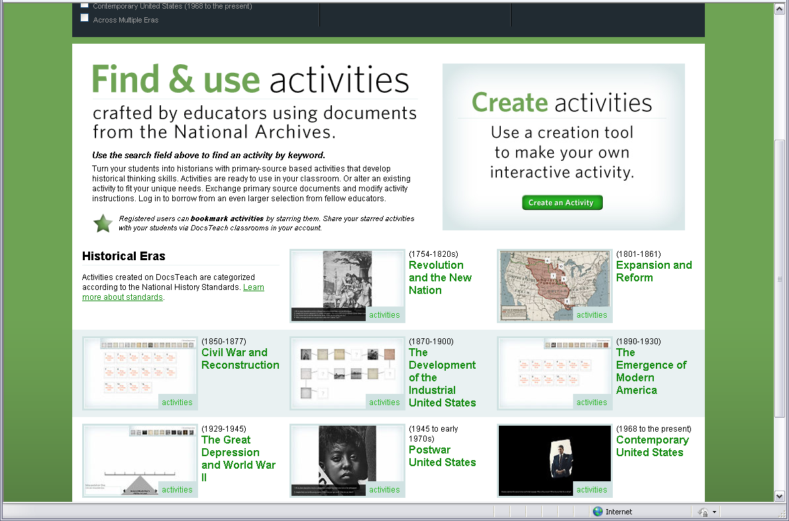
National Archives - DocsTeach – http://docsteach.org
With Docs Teach you can:
Browse or search from “ready-to-roll” activities
2) Customize any of these activities
3) Create a brand new interactive activity with historical thinking-based tools and classroom-ready, online primary sources
Save and organize activities in your
own account

Slide 43
National Archives - DocsTeach – http://docsteach.org
Ready-to-roll activities are based on 1 of 7 tools.
**each designed to teach one or more historical thinking skills**
Finding a Sequence
Present primary sources and challenge students to sequence them based on document analysis
Focusing on Details
Showcase an intriguing document or pair of documents to prompt students to think critically about primary source documents
Interpreting Data
Pose questions for students to solve through analyzing historical data
Making Connections
Present primary sources as a string of documents and help students make connections among those documents and the historical events they illustrate
Mapping History
Link primary sources to locations on a map and practice spatial thinking and understand the impact of geographic factors in history
Seeing the Big Picture
Pair documents concerning a historical event, concept, or figure with descriptions, questions, or other documents to impress upon students that the whole is derived from smaller parts.
Weighing the Evidence
Turn primary sources into historical evidence that students sort through and evaluate to draw historical conclusions.

Slide 44
National Archives - DocsTeach – http://docsteach.org
Browse or search from “ready-to-roll” activities
BY:
Era
Historical Thinking Skill
DocsTeach.org Tool
Keyword
Activity Author
National Archives’ Docs Teach– http://docsteach.org

Slide 45
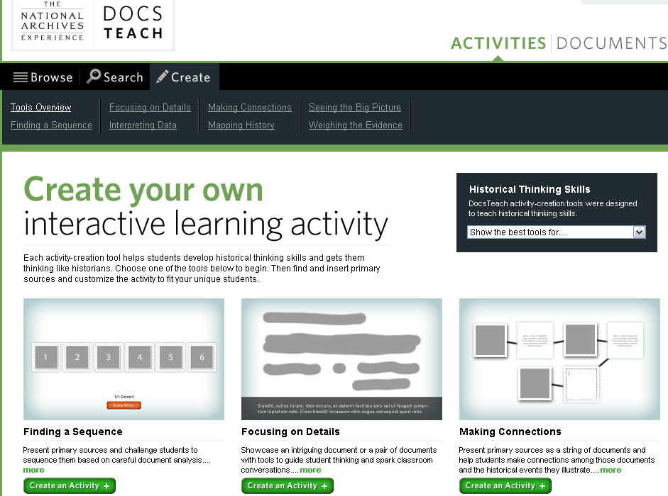
National Archives - DocsTeach – http://docsteach.org
2) Customize any of these activities
3) Create a brand new interactive activity with historical thinking-based tools and classroom-ready, online primary sources

Slide 46
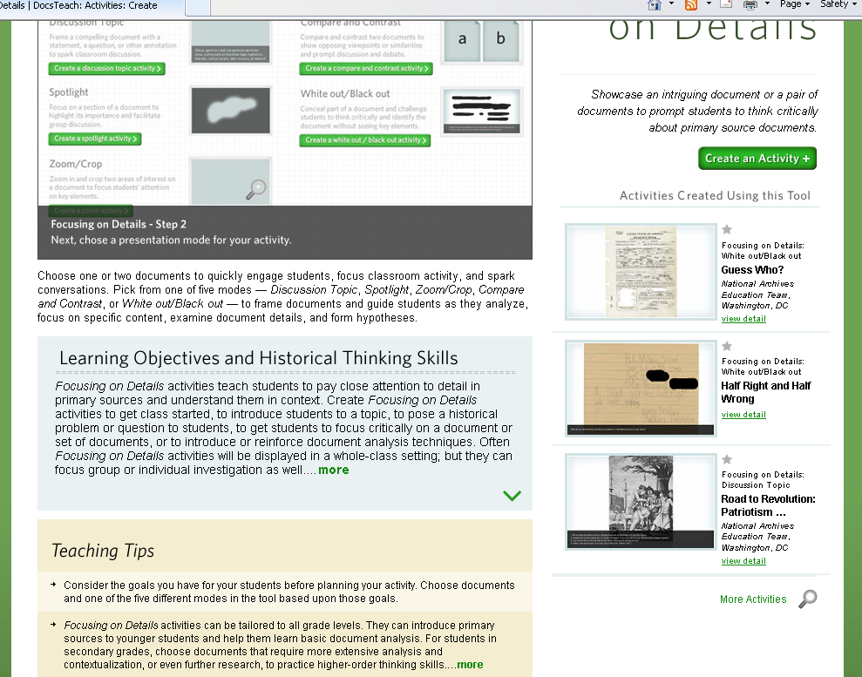
National Archives - DocsTeach – http://docsteach.org
National Archives’ Docs Teach– http://docsteach.org

Slide 47
National Archives - DocsTeach – http://docsteach.org
2) Customize any of these activities
3) Create a brand new interactive activity with historical thinking-based tools and classroom-ready, online primary sources

Slide 48
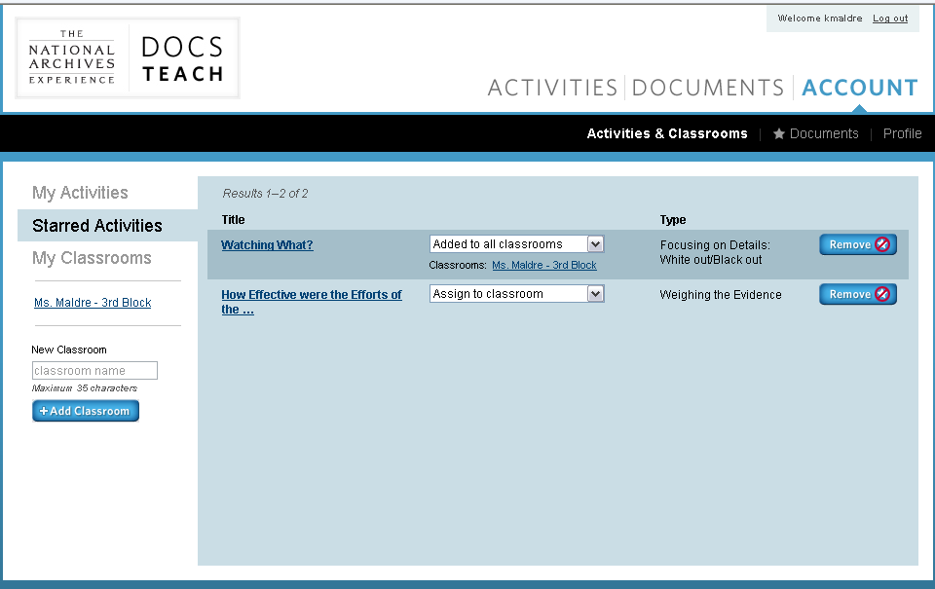
National Archives - DocsTeach – http://docsteach.org
Save and organize activities in your own account

Slide 49
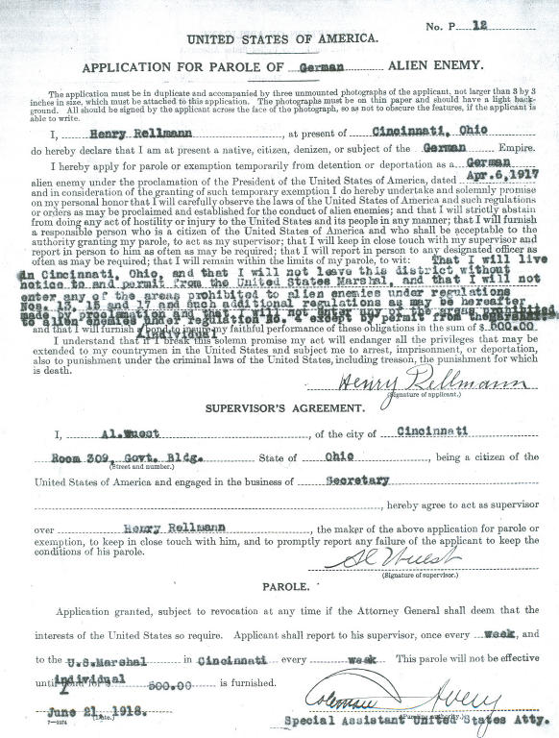
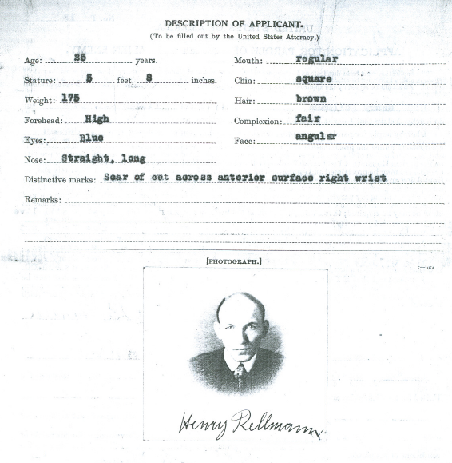
The National Archives at Chicago
World War I: Case Files on Detained Enemy Aliens
National Archives at Chicago – http://www.archives.gov/great-lakes/
Notes:
.

Slide 50
The National Archives at Chicago
World War II: Japanese Internment through Records of the War Relocation Authority
National Archives’ Docs Teach– http://docsteach.org

Slide 51
The National Archives at Chicago
World War II: Japanese Internment through Records of the War Relocation Authority
National Archives’ Docs Teach– http://docsteach.org

Slide 52
The National Archives at Chicago
World War II: Japanese Internment through Records of the War Relocation Authority
National Archives’ Docs Teach– http://docsteach.org

Slide 53
Research at the National Archives at Chicago
After Today
Questions, concerns, eager to brainstorm ideas for your classroom . . .
Kris Maldre, Education Specialist
telephone: 773-948-9010
e-mail: kristina.maldre@nara.gov
National Archives at Chicago – http://www.archives.gov/great-lakes/

Slide 54
Neelam Jumma, School Programs Educator
Danielle Estler, Professional Development Manager
McCormick Foundation Civics Program School Programs & Resources

Slide 55
Object-Based Learning
“The use of objects is key to providing experiences for engaging multiple intelligences”
“Using an object engages the senses, which increases interest and leads to individuals creating a personal connection to the learning.”
“The use of objects in inquiry helps make an abstract idea concrete.”
Guided Inquiry: Learning in the 21st century
Carol Collier Kuhlthau, Ann K. Caspari, Leslie K. Maniotes

Slide 56
Discovery Trunks are available to middle school and high school teachers who are looking for innovative ways to bring their curriculum - and the stories of those who have struggled to help define freedom - to life.
Themed Discovery Trunks feature artifact reproductions and multimedia in kits that illuminate the lives of historical figures such as Barbara Johns, Sojourner Truth, Abraham Lincoln, Alice Paul and Frederick Douglass.
The Discovery Trunk experience provides students with a unique opportunity to engage in hands-on, object-based learning.
Notes:
Discovery Trunks Handout

Slide 57
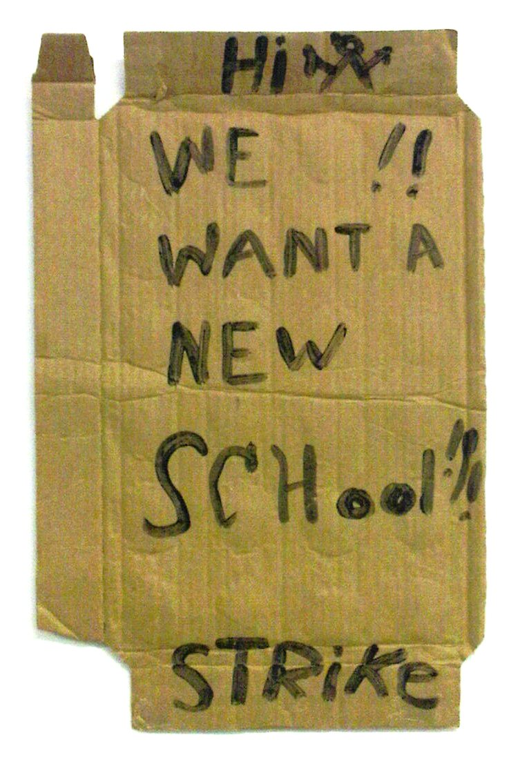
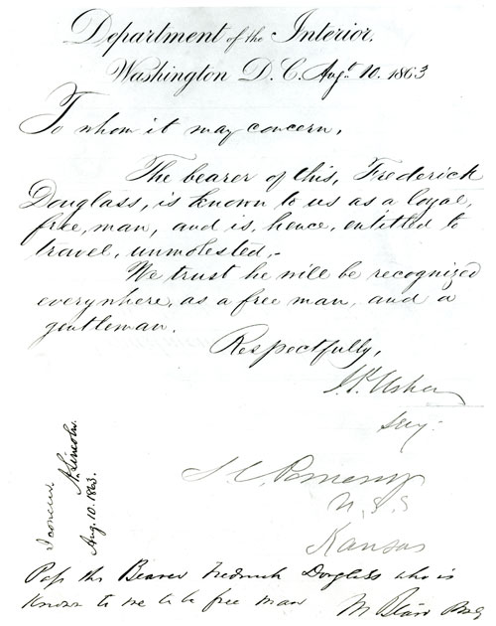
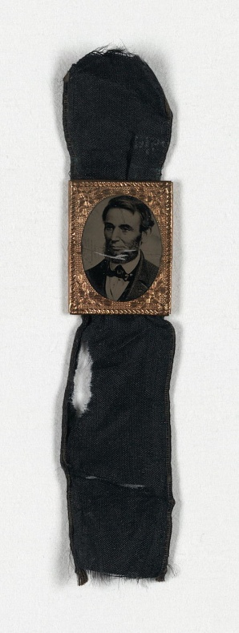
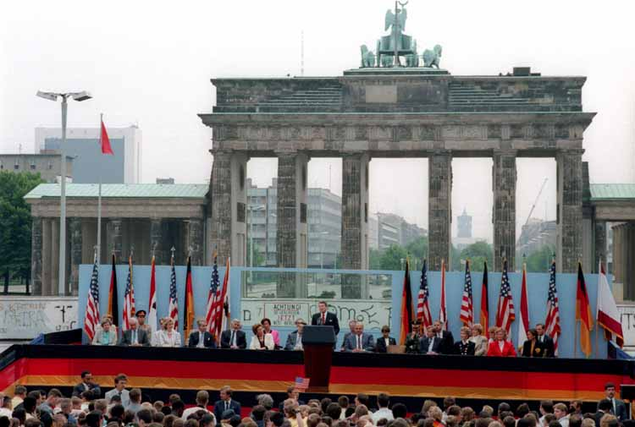
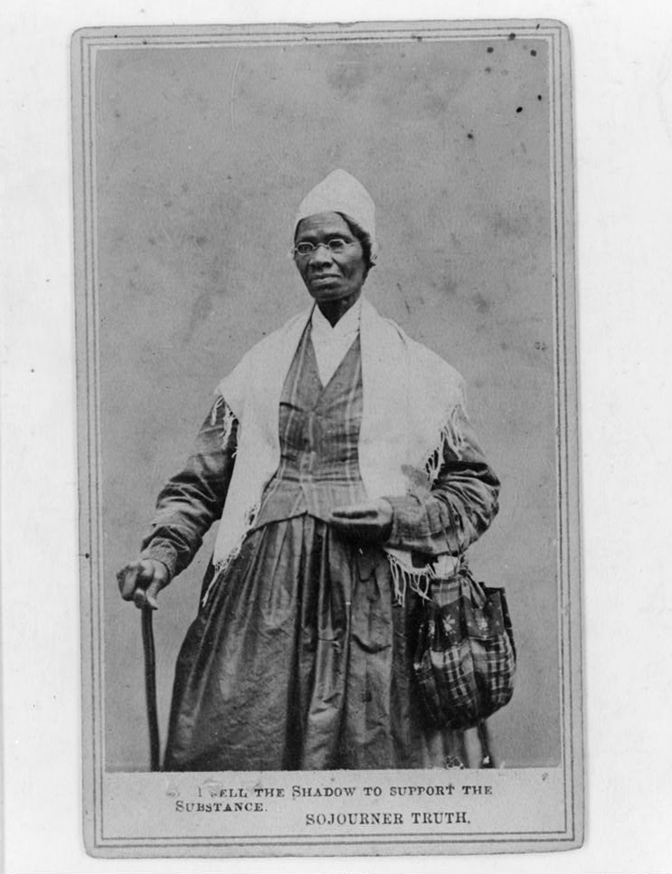
Matthew Lyon
Sequoyah
Sojourner Truth
Abraham Lincoln
Frederick Douglass
Eugene Debs
Alice Paul
Mary Tsukamoto
Barbara Johns
Ronald Reagan

Slide 58
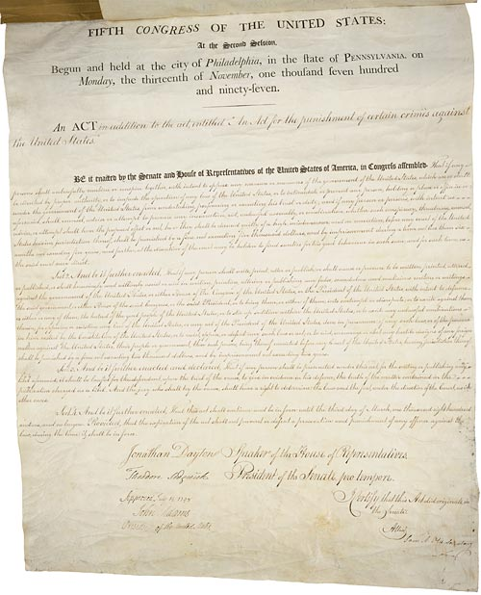
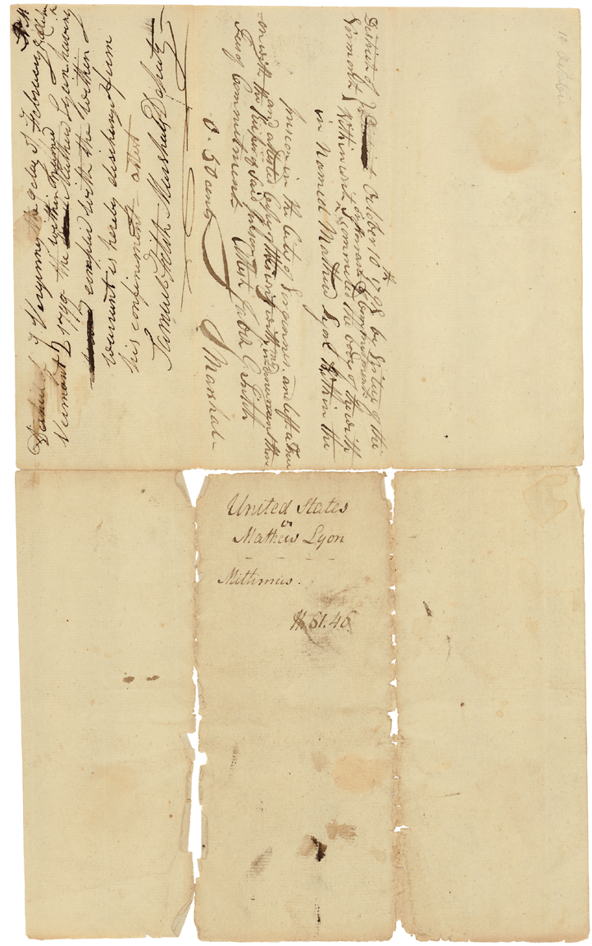
Sedition act
Alien & Sedition Acts - 1798; Fifth Congress; Enrolled Acts and Resolutions; General Records of the United States Government; Record Group 11; National Archives and Records Administration.
Warrant /punishment
Record Group 21: Records of District Courts of the United States, 1685 - 2004ARC ID: 350; Creator: U.S. Circuit Court for the District of Vermont. (1791 - 01/01/1912) Series: Case Files, compiled 1792 - 1869ARC ID: 595562; National Archives and Records Administration, Northeast Region (Boston).
Notes:
The Sedition Act
Federalist President John Adams was elected in 1797. Diplomatic tensions with French officials led to Adams proposing to Congress in 1798 not only a declaration of war but also a number of acts that would curtail civil liberties.
The Alien Act gave the President permission to expel any aliens he felt were "dangerous to the peace and safety of the United States." The Sedition Act went further, targeting U.S. citizens as well. The Sedition Act directly challenged the First Amendment, charging citizens who "oppose any measure or measures of the government of the United States," through "unlawful assembly...counsel, advice or attempt" with punishment including time in prison and fines.
Federalists supported the Sedition Act, seeing speech as a threat to the government. Republicans opposed the act, seeing it as an expansion of presidential power and an assault on the freedom of speech.
Warrant
“This item is the warrant for punishment (mittimus) in the case of U.S. v. Matthew Lyon. It describes the conviction of Lyon, a publisher and member of Congress, for making seditious statements that had been made illegal under the Sedition Act of 1798, and specifies a punishment of four months in jail and a fine of $1,000, plus $60.96 in court costs.”
No friend of the Federalists, Lyon predicted he, as a vocal Republican, would be the first person arrested under the Sedition Act. Sure enough, Lyon was charged in October of 1798 after publishing a number of articles critical of President John Adams.
Serving as his own defense, Lyon argued that the charges were invalid because the Sedition Act was unconstitutional. Unconvinced, the jury returned a guilty verdict and Lyon was sentenced to four months in jail and fined. During his jail sentence, Lyon actively campaigned for re-election, which he secured in a landslide, largely due to the public’s backlash against the Federalists for the Alien and Sedition Acts. The Republican led Congress let the laws expire in 1801.
In 1840, Congress refunded Lyon’s fine plus interest to his heirs. In 2001, Senator Jim Jeffords of Vermont invoked the spirit of Matthew Lyon, remembering the commitment to liberty of the people of his state who "proudly elected Matthew Lyon to Congress, notwithstanding his flouting of the Sedition Act.”

Slide 59
Penn[sylvania] on the picket line, 1917.
Women of Protest: Photographs from the Records of the National Woman's Party, Manuscript Division, Library of Congress, Washington, D.C. [mnwp.160022]
Reproduction Jailed for Freedom Pin
Purchased from the Framingham Historical Society and Museum

Slide 60
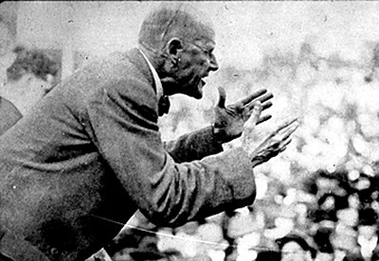
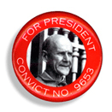
Photo of Eugene Debs
Courtesy of the Eugene V. Debs Foundation.
Debs 1920 Campaign button (reproduction)
Courtesy of the Eugene V. Debs Foundation.
Notes:
Executive Order posted
The day after the bombing of Pearl Harbor, the United States entered World War II. Throughout the rest of 1941 and during the first two months of 1942, the fears of Mary Tsukamoto’s community began to be realized as efforts to protect vulnerable coastal states led to increasingly tighter restrictions on civil liberties - German, Italian, and Japanese were classified as "dangerous enemy aliens,” prohibited zones were established where “enemy aliens” were forbidden, and restricted areas enforced curfews.
On February 19, 1942, President Roosevelt signed Executive Order 9066, which authorized the secretary of war to define military areas "from which any or all persons may be excluded as deemed necessary or desirable."
The Wartime Civil Control Administration (WCCA) and the War Relocation Authority (WRA) were created in March 1942 to handle the evacuation and relocation of Japanese Americans. Upon registration for removal to the relocation centers, Japanese Americans were issued a "family number," used from then on to identify them and their belongings during removal and internment.
“…signs had been nailed to the telephone poles saying that we were to report to various spots. They told us to register as families. We had to report to the Elk Grove Masocin Building where we were given our family number, No. 2076….We found out we were going to the Fresno Assembly Center.”
Packing Canvas
“And we knew we had to take blankets and sheets and bedding and things as well as some of our clothes. And we had no idea whether we were going to a hot place or a cold place, so our family was quite concerned about how to get ready.” – Mary Tsukamoto
The Wartime Civil Control administration (WCCA) didn’t tell the evacuees where they were going, supplied no method to ship belongings and warned that storage provided by the government would be at the owner’s risk.
“…we sold our car for eight hundred dollars, which was just about giving it away. We also had to sell our refrigerator. But some wonderful friends came to ask if they could take care of some things we couldn’t store. Mr. Lernard, a principal of a high school, took my piano and his daughter took our dining room set, which was a wedding gift. Other things we had to sell, and still others things we had to crate. The Japanese community hall was declared the “federal reserve bank,” a warehouse, and some of our things were stored there as well as in the Buddhist Church gymnasium. So people were bringing their stuff, crating it, stacking it up and storing it. Some were working to the very last minute.” – Mary Tsukamoto
By August 7, 1942 over 110,000 Japanese Americans had been removed from the West coast. They were transported to one of sixteen assembly centers California, Washington, Oregon and Arizona by bus and train, accompanied by armed military guards. The assembly centers, hastily erected at racetracks, fairgrounds, livestock pavilions, were intended to be temporary housing, but many people stayed for up to three months because inland internment camps were not yet built.

Slide 61
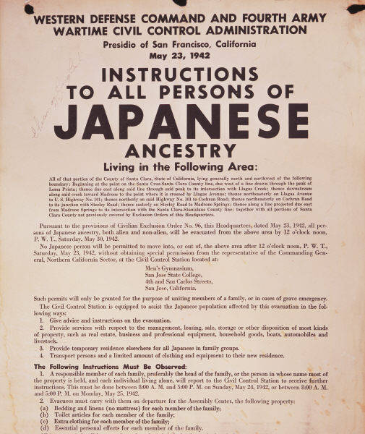
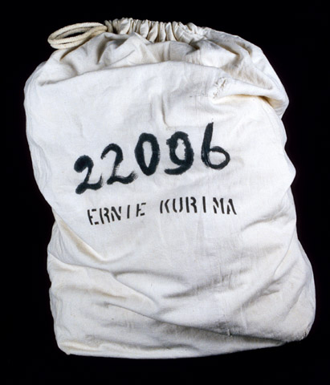
Executive Order posted.
Reproduction based on San Francisco, California. Exclusion Order posted at First and Front Streets 04/11/1942
ARC Identifier 536017 / Local Identifier 210-G-A39 Item from Record Group 210: Records of the War Relocation Authority, 1941 - 1989
Packing canvas with family number
Reproduction based on original in on-line exhibition "A More Perfect Union: Japanese-Americans and the U.S. Constitution." Accessed at http://americanhistory.si.edu/perfectunion/experience/index.html
Notes:
Executive Order posted
The day after the bombing of Pearl Harbor, the United States entered World War II. Throughout the rest of 1941 and during the first two months of 1942, the fears of Mary Tsukamoto’s community began to be realized as efforts to protect vulnerable coastal states led to increasingly tighter restrictions on civil liberties - German, Italian, and Japanese were classified as "dangerous enemy aliens,” prohibited zones were established where “enemy aliens” were forbidden, and restricted areas enforced curfews.
On February 19, 1942, President Roosevelt signed Executive Order 9066, which authorized the secretary of war to define military areas "from which any or all persons may be excluded as deemed necessary or desirable."
The Wartime Civil Control Administration (WCCA) and the War Relocation Authority (WRA) were created in March 1942 to handle the evacuation and relocation of Japanese Americans. Upon registration for removal to the relocation centers, Japanese Americans were issued a "family number," used from then on to identify them and their belongings during removal and internment.
“…signs had been nailed to the telephone poles saying that we were to report to various spots. They told us to register as families. We had to report to the Elk Grove Masocin Building where we were given our family number, No. 2076….We found out we were going to the Fresno Assembly Center.”
Packing Canvas
“And we knew we had to take blankets and sheets and bedding and things as well as some of our clothes. And we had no idea whether we were going to a hot place or a cold place, so our family was quite concerned about how to get ready.” – Mary Tsukamoto
The Wartime Civil Control administration (WCCA) didn’t tell the evacuees where they were going, supplied no method to ship belongings and warned that storage provided by the government would be at the owner’s risk.
“…we sold our car for eight hundred dollars, which was just about giving it away. We also had to sell our refrigerator. But some wonderful friends came to ask if they could take care of some things we couldn’t store. Mr. Lernard, a principal of a high school, took my piano and his daughter took our dining room set, which was a wedding gift. Other things we had to sell, and still others things we had to crate. The Japanese community hall was declared the “federal reserve bank,” a warehouse, and some of our things were stored there as well as in the Buddhist Church gymnasium. So people were bringing their stuff, crating it, stacking it up and storing it. Some were working to the very last minute.” – Mary Tsukamoto
By August 7, 1942 over 110,000 Japanese Americans had been removed from the West coast. They were transported to one of sixteen assembly centers California, Washington, Oregon and Arizona by bus and train, accompanied by armed military guards. The assembly centers, hastily erected at racetracks, fairgrounds, livestock pavilions, were intended to be temporary housing, but many people stayed for up to three months because inland internment camps were not yet built.

Slide 62
Jigsaw Approach
Collaborative learning method that emphasizes connections and relationships in the content.
Each student is responsible for an essential part of the material, or “piece of the puzzle.”

Slide 63
Jigsaw Approach
Each student in a “home” group receives one part of the information, thus each student is responsible for a different piece of information.
Students leave the “home” group and join “expert” groups, in which all the members have the same piece of information.
Students return to the “home” group, where each teaches the rest the part of the information on which they are now “experts.”
Students work cooperatively in “home” and “expert” groups.
Instructional Strategies for Middle and High School, Bruce E. Larson and Timothy A. Keiper

Slide 64
The Freedom Express & Liberties in Wartime

Slide 65
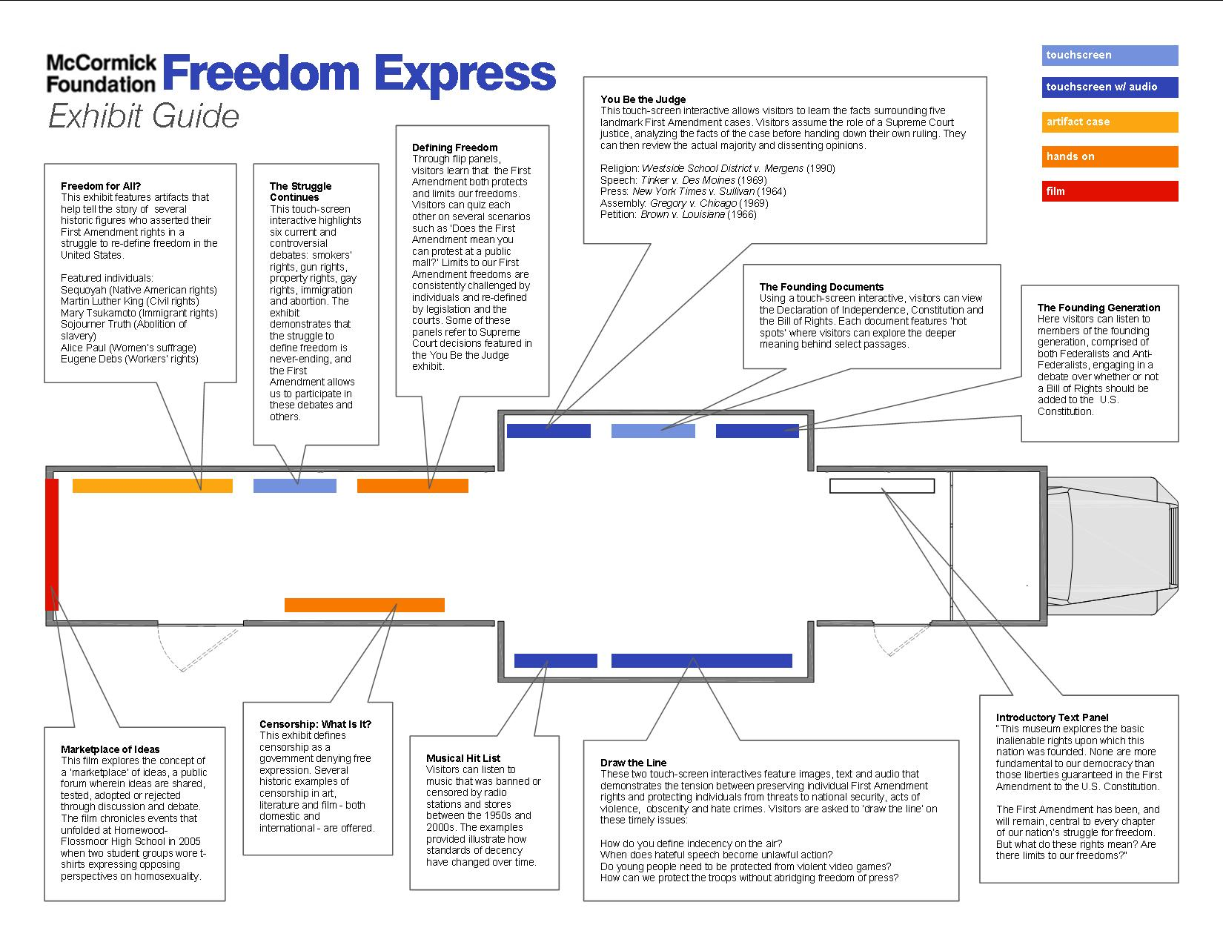
Exhibits relating to liberties in wartime

Slide 66
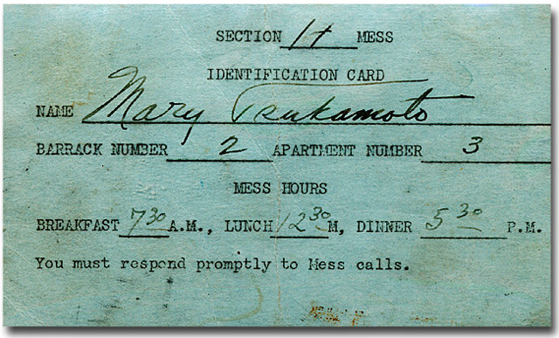
Faces of Freedom
This exhibit features artifacts that help tell the story of several historic figures who asserted their First Amendment rights in a struggle to re-define freedom in the United States.
Mary Tsukamoto (Immigrants’ Rights)
U.S. citizen of Japanese ancestry who was relocated to an internment camp during World War II
Due to the large number of people in the camps, the mess halls provided meals in shifts, as seen on Mary Tsukamoto’s Mess Hall I.D. card.

Slide 67
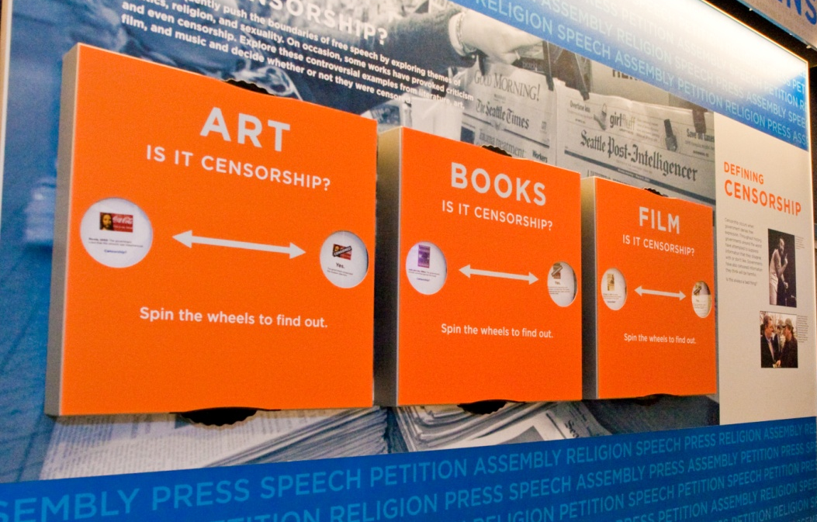
Censorship Wheels
This exhibit defines censorship and shows both domestic and international examples of censorship in art, literature and film.
Three international examples of expression censored during wartime:
A Farewell to Arms by Ernest Hemingway
1929 – Italian government banned it due to unflattering account of an Italian retreat during World War I
Bambi by Felix Salten
1936 – The Nazi government in Germany banned it because it was written by a Jewish author during World War II
The Great Dictator featuring Charlie Chaplin
1940 – Chicago police department refused to issue a permit for the exhibition of this movie out of respect for German population in city

Slide 68
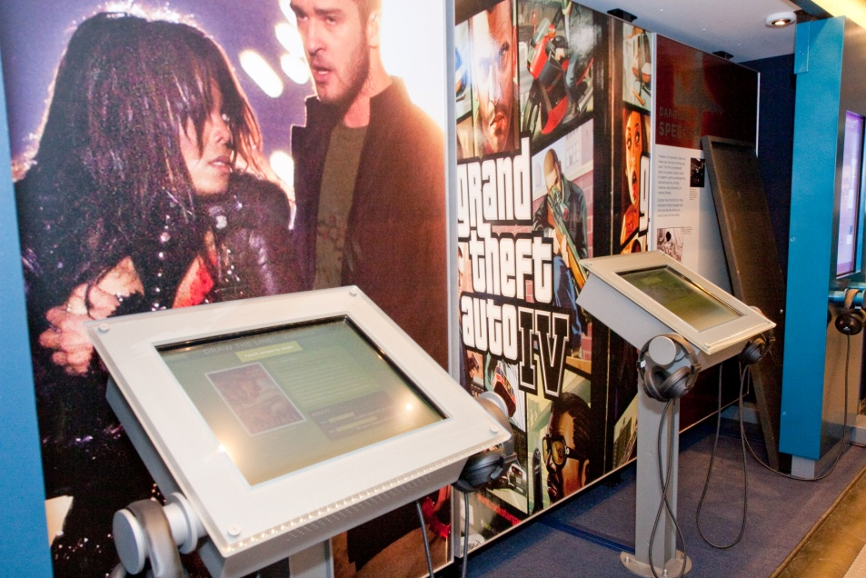
Draw the Line
These two touch-screen interactives feature images, text and audio that demonstrate the tension between preserving individual First Amendment rights and protecting individuals from threats to national security, acts of violence, obscenity and hate crimes. Visitors are asked to ‘draw the line’ on these timely issues.
Freedom of press in wartime:
1860s: Abraham Lincoln shut down newspapers and jailed reporters critical of Civil War bloodshed
1942: During World War II, Franklin Roosevelt’s administration charged the Tribune with espionage for its coverage of the Battle of Midway
1971: During the Vietnam War, Pentagon employee Daniel Ellsberg leaked top-secret papers to the New York Times and Washington Post. The government stopped their publication
2003: TV reporter Geraldo Rivera drew a sand diagram to show U.S. troop positions during the Iraq invasion.

Slide 69
McCormick Foundation Civics Program Primary Sources Activity

Slide 70
Additional Resources
The National Archives Docs Teach
http://docsteach.org/
National Archives Digital Classroom http://www.archives.gov/education/
Library of Congress – Teaching with Primary Sources http://www.loc.gov/teachers/
Smithsonian Source - Resources for Teaching American History http://www.smithsoniansource.org/
Social Education Teaching with Documents series http://www.socialstudies.org/socialeducation
Stanford History Education Group
http://sheg.stanford.edu/

